Slide 1
Home Page Redesign Usability Test pictures for research report
Aug 31, 2022
Cindy Merrill

Slide 2
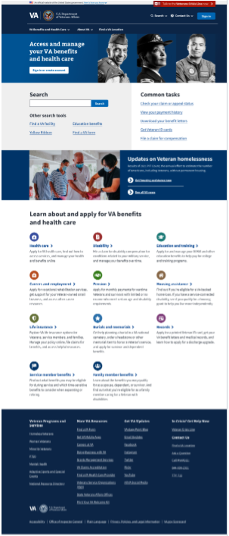
Areas of the redesigned VA.gov
home page
Sign in/create acct
Header
New search box
Common tasks
Other search tools
Vantage blog promo
Benefit hubs
Footer

Slide 3
% of 19 research participants who clicked in each area
74%
16%
Where people clicked:
Header (74% = 14/19 participants)
Common tasks (68% = 13/19)
Benefit hubs (68% = 13/19)
Other search tools (63% = 12/19)
New search box (47% = 9/19)
Footer (21% = 4/19)
Sign in or create account button (16% = 3/19)
*0% is OK because we didn’t have any tasks that related to the Vantage part of the page
47%
68%
63%
0%*
Key:
70-100%
50-69%
25-49%
10-24%
0-9%
68%
21%

